Slide 1

TELECOM NETWORK SURVEY & ANALYSIS
(2024)
Ejikeme Ekene Samuel
June, 2025.
Notes:
Front page

Slide 2
INTRODUCTION
This dataset provides insights into the operational and
usage patterns of Telecom Network users over a
specified period (28th April – 5th May, 2025). It contains
records related to user activities, age, state of origin,
most used apps, religion, amount spent on data weekly, monthly income range and monthly savings.
Notes:
Introduction

Slide 3
PROCESS WORKFLOW
Data Collection
Data Cleaning
Analysis & Insights
Visualization
Recommendations
Conclusion
Notes:
Process workflow

Slide 4
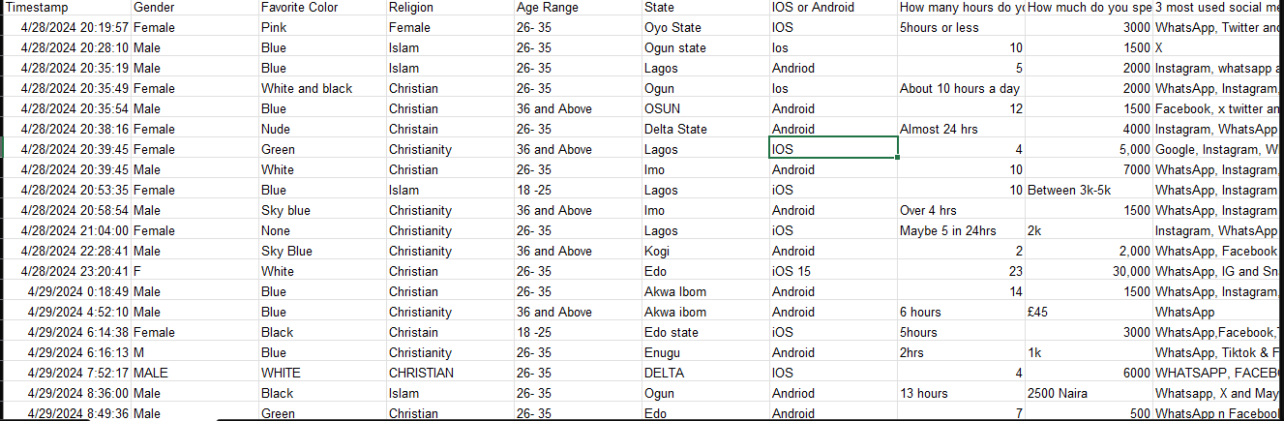
UNCLEAN DATASET
Notes:
Unclean Dataset

Slide 5
DATA CLEANING PROCESS
Checked missing values
Correct typos and errors
Filtered out irrelevant data
Trimmed spaces
Created consistent categories and
Data type conversion
Notes:
Data Cleaning Process

Slide 6
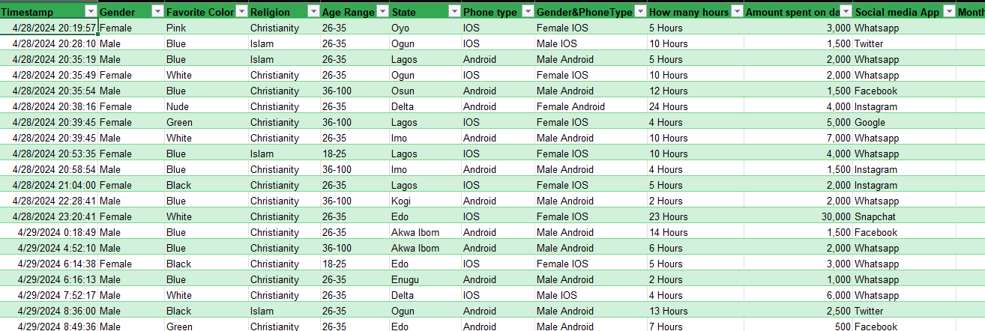
CLEANED DATASET
Notes:
Clean Dataset

Slide 7
ANALYSIS & INSIGHTS
Total user:
132
Male: 68
Android users: 69
Female: 64
IOS users: 61
Android & IOS users: 2
Data revenue weekly: 2.7m
#1 social media app: WhatsApp
Highest Income State: LAGOS
Notes:
Insights and Analysis

Slide 8
DASHBOARD
Notes:
Data Visualization

Slide 9
RECOMMENDATIONS
> The Company Should Strengthen Customer Relationships
* Introduce a referral program
* Improve customer services response time
* Gather testimonials and turn them into adverts.
> Joint Social Media Promotion
* The company should run a promo between WhatsApp and other less used social
media apps like YouTube, Google and TikTok.
> Offer Promotions towards month ends
* Based on the daily response trends, the company should consider end of the month
promotions to attract more customers
Notes:
Recommendation

Slide 10
CONCLUSION
This mini presentation created a comprehensive and relatable dashboard alongside Insights and recommendations using the provided dataset which would help optimize the company services.
Notes:
Conclusion

Slide 11
Thank you!

